Slide 1
Module 9 - Local Storage & Persistence in Flutter

Slide 2
Learning Objectives
Content:
Understand the 3 main local storage methods in Flutter
Store & retrieve key–value data with SharedPreferences
Read & write local JSON files using Dart IO
Build CRUD operations using SQLite (sqflite)
Apply offline-first strategies to improve user experience
Combine multiple storage methods into a practical mini-app

Slide 3
Why Local Storage?
Key Concepts
Local storage is data saved directly on the user's device:
Available offline
Persistent across restarts
Faster than API calls
Stores personalized user choices
Examples:
Dark mode settings
Recently viewed items
Saved filters
Favorites/watchlist
Onboarding flag (“first-time user?”)
Local storage = better UX + higher app reliability.

Slide 4
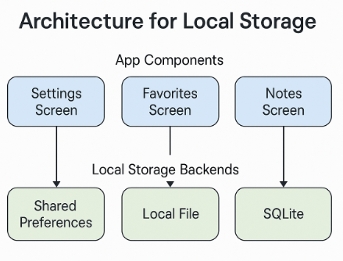
Types of Local Storage in Flutter
Storage Type | Best Use | Example
SharedPreferences | Simple key–value | Settings, flags
JSON File (dart:io) | Simple lists, export | Notes, history
SQLite (sqflite) | Structured relational | Todo app
Notes:
Clarify why this module focuses on SharedPreferences + JSON + SQLite preview.

Slide 5
What is SharedPreferences?
Lightweight and easy to use
Stores simple key-value pairs
Persistent across app restarts
Works synchronously and asynchronously
NOT for complex objects or large data
Example use cases:
Dark/Light theme preference
“Onboarding completed” flag
User login state
Default filter/sort mode

Slide 6
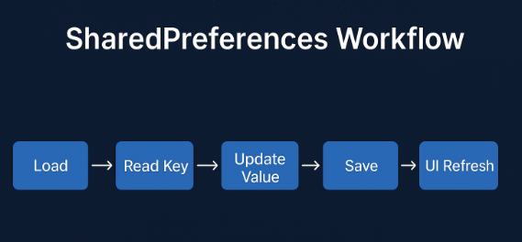
SharedPreferences Workflow
What it does
Stores simple key–value data on the device.
Data persists even after the app is closed or restarted.
Process
Load SharedPreferences instance
Read stored values
Update values when the user interacts
Save the new key–value pairs
Refresh UI to reflect updated data
Notes:
Instructor Notes:
Highlight separation of concerns → maintainability & testability.

Slide 7
SharedPreferences Support Across Environments
Environment | SharedPreferences Support? | Notes
Flutter App (Android/iOS) | ✅ Yes | Saves data to the device’s persistent storage. Reopen the app → data remains.
Flutter Web | ✅ Yes (via localStorage) | SharedPreferences automatically maps to browser localStorage.
DartPad (Flutter Mode) | ❌ Not supported | No native storage → must use a FakePrefs mock class.
DartPad (Dart Mode) | ❌ No | No plugins and no Flutter widgets. Pure Dart environment only.

Slide 8
Demo 9.1: Saving App Settings
OBJECTIVES
Understand how to store simple data using SharedPreferences.
Save theme state (dark/light) and retain it when reopening the app.
Practice the lifecycle: load → update → save → refresh UI.
Compare how to use SharedPreferences on a real device and when there is no native storage (DartPad).
Steps
Add dependency: shared_preferences: ^2.x.x
Load saved theme: use SharedPreferences.getInstance() and read "isDarkMode"
Update state: toggle the switch to change the theme
Save value: prefs.setBool("isDarkMode", value)
Refresh UI: call setState() (or use a state management tool)
Restart app: the saved theme is restored automatically
Notes:
Steps (DartPad Version)
No SharedPreferences plugin in DartPad → use a mock class (FakePrefs)
Load initial value from an in-memory map
Update state when the switch is toggled
Save value back into the mock storage
Refresh UI using setState()
Note: data resets on reload (not persistent)

Slide 9
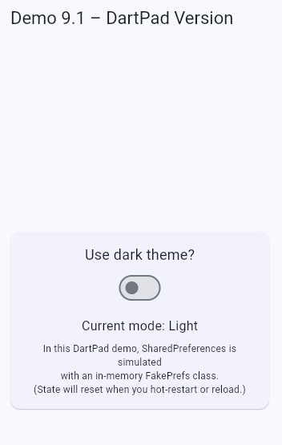
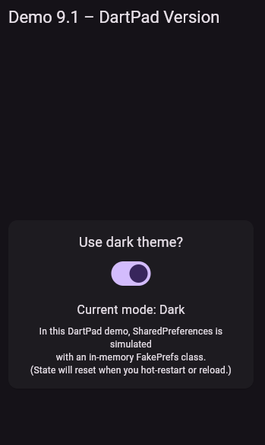
Demo 9.1: Saving App Settings
Steps (DartPad Version)
No SharedPreferences plugin in DartPad → use a mock class (FakePrefs)
Load initial value from an in-memory map
Update state when the switch is toggled
Save value back into the mock storage
Refresh UI using setState()
Note: data resets on reload (not persistent)
Notes:
Code demo 9.1 Saving App Settings (DartPad Version)
import 'package:flutter/material.dart';
void main() {
runApp(const Demo91DartPadApp());
}
/// Fake SharedPreferences for DartPad (in-memory only)
class FakePrefs {
static final Map<String, Object> _store = {};
Future<void> setBool(String key, bool value) async {
_store[key] = value;
}
bool getBool(String key) {
final value = _store[key];
if (value is bool) return value;
return false;
}
}
class Demo91DartPadApp extends StatefulWidget {
const Demo91DartPadApp({super.key});
@override
State<Demo91DartPadApp> createState() => _Demo91DartPadAppState();
}
class _Demo91DartPadAppState extends State<Demo91DartPadApp> {
final FakePrefs _prefs = FakePrefs();
bool _isDarkMode = false;
@override
void initState() {
super.initState();
_loadTheme();
}
void _loadTheme() {
final saved = _prefs.getBool('darkMode');
setState(() {
_isDarkMode = saved;
});
}
Future<void> _toggleTheme(bool value) async {
await _prefs.setBool('darkMode', value);
setState(() {
_isDarkMode = value;
});
}
@override
Widget build(BuildContext context) {
final ThemeData lightTheme = ThemeData(
colorScheme: ColorScheme.fromSeed(
seedColor: Colors.blue,
brightness: Brightness.light,
),
useMaterial3: true,
);
final ThemeData darkTheme = ThemeData(
colorScheme: ColorScheme.fromSeed(
seedColor: Colors.deepPurple,
brightness: Brightness.dark,
),
useMaterial3: true,
);
return MaterialApp(
title: 'Demo 9.1 – Mock SharedPreferences',
theme: lightTheme,
darkTheme: darkTheme,
themeMode: _isDarkMode ? ThemeMode.dark : ThemeMode.light,
debugShowCheckedModeBanner: false,
home: Scaffold(
appBar: AppBar(
title: const Text('Demo 9.1 – DartPad Version'),
),
body: Center(
child: Card(
margin: const EdgeInsets.all(16),
child: Padding(
padding: const EdgeInsets.all(16),
child: Column(
mainAxisSize: MainAxisSize.min,
children: [
const Text(
'Use dark theme?',
style: TextStyle(fontSize: 18),
),
const SizedBox(height: 8),
Switch(
value: _isDarkMode,
onChanged: _toggleTheme,
),
const SizedBox(height: 16),
Text(
'Current mode: ${_isDarkMode ? 'Dark' : 'Light'}',
style: const TextStyle(fontSize: 16),
),
const SizedBox(height: 8),
const Text(
'In this DartPad demo, SharedPreferences is simulated\n'
'with an in-memory FakePrefs class.\n'
'(State will reset when you hot-restart or reload.)',
textAlign: TextAlign.center,
style: TextStyle(fontSize: 12),
),
],
),
),
),
),
),
);
}
}

Slide 10
Why Use Local Files? File Storage Basics
You need files when:
Data is bigger than key–value storage
Data has structure but doesn't require SQL
You want simple offline documents
You want to export/import JSON
You want to cache API responses locally
Key packages:
path_provider → find app directories
dart:io → read/write
json.encode / json.decode
Short snippet:
final file = File(path);
await file.writeAsString(jsonString);
final content = await file.readAsString();

Slide 11
Key-Value Persistence Overview
What Is Key-Value Storage?
Lightweight way to store small app settings
Data saved by key → value pairs
Used for: theme mode, username, onboarding flags, user preferences
How It Works Across Environments
Flutter App (Android/iOS): SharedPreferences → device storage
Flutter Web: maps to browser localStorage
DartPad: plugins not supported → use custom FakePrefs
High-Level Flow
Load storage instance → Read existing value → Update value based on user action →Save back to storage → Refresh the UI
Notes:
This slide sets the foundation before walking through the actual demo (9.2). We highlight conceptual correctness across all platforms even when DartPad can’t use real SharedPreferences

Slide 12
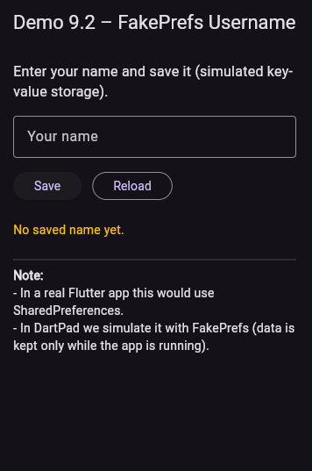
Demo 9.2: Key-Value Storage (DartPad Version)”
Objective
Simulate key-value storage using a mock class (FakePrefs)
Save and load a simple value (e.g., username)
Steps
Create a FakePrefs class to simulate SharedPreferences
Initialize storage using FakePrefs.getInstance()
Load saved value into the TextField on startup
Update value when user edits the input
Save value using setString(key, value)
Refresh UI with setState()
Notes:
(Note) Data resets on reload — DartPad has no persistent storage
Code demo 9.2
import 'package:flutter/material.dart';
void main() {
runApp(const Demo92App());
}
/// Demo 9.2 – Simulated key-value storage (DartPad-safe)
class Demo92App extends StatelessWidget {
const Demo92App({super.key});
@override
Widget build(BuildContext context) {
return MaterialApp(
title: 'Demo 9.2 – FakePrefs',
theme: ThemeData.dark(), // dùng theme đơn giản, tránh lỗi brightness
debugShowCheckedModeBanner: false,
home: const UsernamePrefsScreen(),
);
}
}
/// ----- FakePrefs: mô phỏng SharedPreferences cho DartPad -----
class FakePrefs {
FakePrefs._internal();
static final FakePrefs _instance = FakePrefs._internal();
// map lưu dữ liệu key-value trong RAM
final Map<String, Object?> _storage = {};
// mô phỏng SharedPreferences.getInstance()
static Future<FakePrefs> getInstance() async {
// delay nhẹ cho giống async I/O thật
await Future.delayed(const Duration(milliseconds: 200));
return _instance;
}
String? getString(String key) => _storage[key] as String?;
Future<bool> setString(String key, String value) async {
await Future.delayed(const Duration(milliseconds: 100));
_storage[key] = value;
return true;
}
}
/// ----- UI demo: lưu / đọc tên người dùng -----
class UsernamePrefsScreen extends StatefulWidget {
const UsernamePrefsScreen({super.key});
@override
State<UsernamePrefsScreen> createState() => _UsernamePrefsScreenState();
}
class _UsernamePrefsScreenState extends State<UsernamePrefsScreen> {
final TextEditingController _controller = TextEditingController();
bool _isLoading = true;
String _status = 'Loading saved name...';
static const String _keyUsername = 'username';
@override
void initState() {
super.initState();
_loadUsername();
}
// Step 1: load dữ liệu đã lưu (nếu có)
Future<void> _loadUsername() async {
final prefs = await FakePrefs.getInstance();
final saved = prefs.getString(_keyUsername);
setState(() {
_controller.text = saved ?? '';
_status = saved == null ? 'No saved name yet.' : 'Loaded saved name.';
_isLoading = false;
});
}
// Step 2: lưu dữ liệu mới
Future<void> _saveUsername() async {
final name = _controller.text.trim();
if (name.isEmpty) {
setState(() {
_status = 'Please enter a name before saving.';
});
return;
}
setState(() => _isLoading = true);
final prefs = await FakePrefs.getInstance();
await prefs.setString(_keyUsername, name);
setState(() {
_status = 'Saved "$name" to FakePrefs.';
_isLoading = false;
});
}
@override
Widget build(BuildContext context) {
return Scaffold(
appBar: AppBar(
title: const Text('Demo 9.2 – FakePrefs Username'),
),
body: Padding(
padding: const EdgeInsets.all(16),
child: Column(
crossAxisAlignment: CrossAxisAlignment.start,
children: [
const Text(
'Enter your name and save it (simulated key-value storage).',
style: TextStyle(fontSize: 16),
),
const SizedBox(height: 16),
TextField(
controller: _controller,
decoration: const InputDecoration(
labelText: 'Your name',
border: OutlineInputBorder(),
),
),
const SizedBox(height: 16),
Row(
children: [
ElevatedButton(
onPressed: _isLoading ? null : _saveUsername,
child: _isLoading
? const SizedBox(
height: 16,
width: 16,
child: CircularProgressIndicator(strokeWidth: 2),
)
: const Text('Save'),
),
const SizedBox(width: 12),
OutlinedButton(
onPressed: _isLoading ? null : _loadUsername,
child: const Text('Reload'),
),
],
),
const SizedBox(height: 24),
Text(
_status,
style: const TextStyle(fontSize: 14, color: Colors.amber),
),
const SizedBox(height: 16),
const Divider(),
const Text(
'Note:',
style: TextStyle(fontWeight: FontWeight.bold),
),
const Text(
'- In a real Flutter app this would use SharedPreferences.\n'
'- In DartPad we simulate it with FakePrefs (data is kept only '
'while the app is running).',
),
],
),
),
);
}
@override
void dispose() {
_controller.dispose();
super.dispose();
}
}

Slide 13
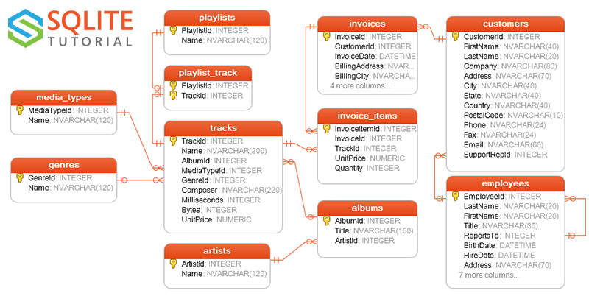
Why SQLite?
Use SQLite when your app needs:
Structured data (rows, columns)
Fast read/write operations
Sorting & filtering (ORDER BY, WHERE)
Data relationships (1–N, N–N)
Long-term reliable storage
Offline capability
Real Use Cases
To-Do / Notes app - Inventory tracking
Offline e-commerce cart - Local user profile database - Bookmark / favorites storage

Slide 14
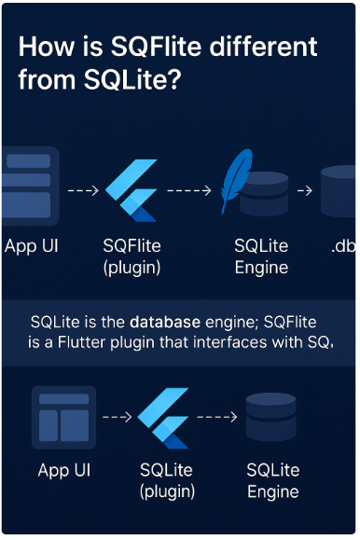
SQFLite vs SQLite: What’s the Difference?
Why not name it SQLite?
SQLite = the actual storage engine
SQFlite = Flutter SDK wrapper built on top of SQLite
The “F” in SQFlite = Flutter (SQLite for Flutter)
Why this matters?
SQFlite is not a database, but a plugin
Helps clarify why SQFlite doesn’t work on Web
Explains that database operations still follow real SQL rules
Notes:
Instructor Notes
Emphasize that SQFlite is a bridge between Dart and SQLite
Remind students: SQLite only works on mobile, not on Flutter Web
Good to introduce before teaching CRUD + SQL syntax in next slides

Slide 15
SQLite vs SQFlite
Component | What it is | Role
SQLite Engine | A lightweight relational database engine | Stores and queries data locally
SQFlite Plugin | A Flutter plugin written in Dart + native code | Bridges Flutter → SQLite
App UI (Flutter Widgets) | Your application screens | Sends commands to SQFlite
Database File (.db) | Local file stored on the device | Holds tables & records

Slide 16
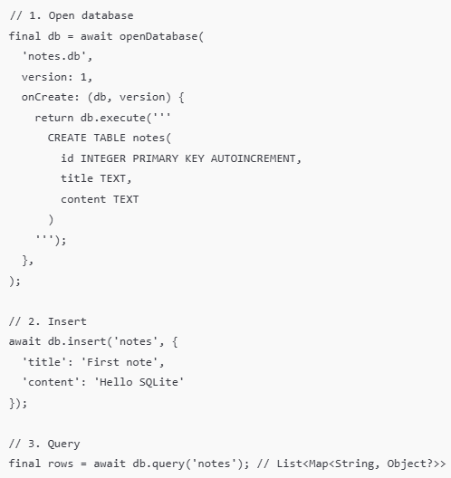
SQFlite Basics (CRUD + Setup)
Key points
sqflite = SQLite database for Flutter (Android, iOS)
Work with Database object:
openDatabase() – open/create DB
onCreate – create tables (run CREATE TABLE)
insert() – add a row
query() – read rows
update() – change rows
delete() – remove rows
Notes:
Note: openDatabase should only be called once (or use singleton / service).query() returns List<Map<String, dynamic>> → need to map to model.

Slide 17
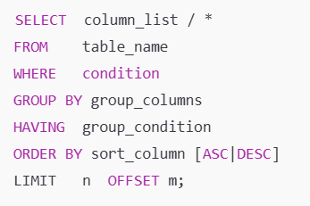
SQL SELECT Recap (for SQFlite)
Syntax block
SELECT – which columns to return
FROM – which table
WHERE – filter rows
GROUP BY + HAVING – group & filter groups (for SUM, COUNT, …)
ORDER BY – sort result
LIMIT / OFFSET – pagination (useful for mobile lists)

Slide 18
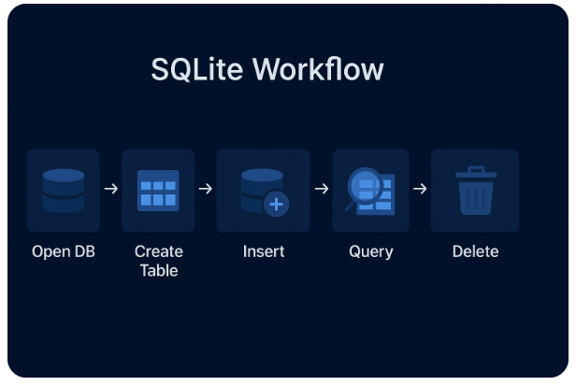
Database Workflow Diagram
Why this matters
SQLite operations follow a predictable lifecycle.
Understanding the flow helps reduce bugs and avoid bad database practices.
Applies to: SQFlite, Moor/Drift, Hive (conceptually), and most SQL engines.
Notes:
Instructor Notes
Stress that the DB is opened only once and reused.
SQLite operations are async → must await db.query() etc.
Best practice: Keep DB logic inside a Database Helper / Service class.
Demo 9.3 follows exactly this workflow (Todo App).

Slide 19
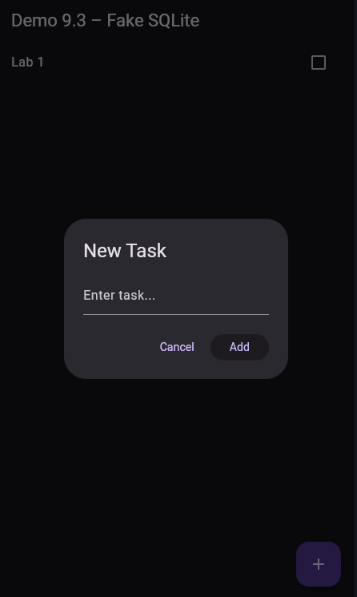
Demo 9.3: Offline Todo App (SQLite)
Objective
Build a simple offline Todo list.
Simulate SQLite CRUD using an in-memory FakeDatabase
Practice insert, query, update, delete before real SQFLite
Steps
Create Todo model
Implement FakeDatabase (insert/query/update/delete)
Load todos on startup
Add new todo (dialog → insert)
Toggle completed (update)
Delete task (Dismissible → delete)
Refresh UI after each operation
Notes:
Code demo 9.3: Offline Todo App (SQLite)
import 'package:flutter/material.dart';
void main() {
runApp(const TodoApp());
}
/// STEP 7: Root app + theme + home screen
class TodoApp extends StatelessWidget {
const TodoApp({super.key});
@override
Widget build(BuildContext context) {
return MaterialApp(
title: 'Demo 9.3 – Fake SQLite (DartPad)',
theme: ThemeData.dark(useMaterial3: true),
home: const TodoListScreen(),
debugShowCheckedModeBanner: false,
);
}
}
/// STEP 2: Fake "SQLite" database implemented in memory
class FakeDatabase {
FakeDatabase._internal();
static final FakeDatabase instance = FakeDatabase._internal();
// Simulate a table: id, title, isDone
final List<Map<String, dynamic>> _table = [];
int _autoId = 0;
/// STEP 3: Query all rows (SELECT * FROM todos ORDER BY id DESC)
Future<List<Map<String, dynamic>>> queryAll() async {
await Future.delayed(const Duration(milliseconds: 80)); // fake delay
return List.from(_table.reversed);
}
/// STEP 4: Insert a new row (INSERT)
Future<int> insert(String title) async {
await Future.delayed(const Duration(milliseconds: 80));
final row = {
"id": ++_autoId,
"title": title,
"isDone": 0,
};
_table.add(row);
return row["id"] as int; // explicit cast to fix DartPad error
}
/// STEP 5: Update an existing row (UPDATE)
Future<void> update(int id, bool isDone) async {
await Future.delayed(const Duration(milliseconds: 80));
final index = _table.indexWhere((row) => row["id"] == id);
if (index != -1) {
_table[index]["isDone"] = isDone ? 1 : 0;
}
}
/// STEP 6: Delete a row (DELETE)
Future<void> delete(int id) async {
await Future.delayed(const Duration(milliseconds: 80));
_table.removeWhere((row) => row["id"] == id);
}
}
/// STEP 1: Todo model mapped from/to DB rows
class Todo {
final int id;
final String title;
final bool isDone;
Todo({
required this.id,
required this.title,
required this.isDone,
});
factory Todo.fromMap(Map<String, dynamic> map) {
return Todo(
id: map["id"],
title: map["title"],
isDone: map["isDone"] == 1,
);
}
}
/// STEP 3–7: Main Todo list screen (load, add, update, delete)
class TodoListScreen extends StatefulWidget {
const TodoListScreen({super.key});
@override
State<TodoListScreen> createState() => _TodoListScreenState();
}
class _TodoListScreenState extends State<TodoListScreen> {
final db = FakeDatabase.instance;
List<Todo> todos = [];
bool loading = true;
@override
void initState() {
super.initState();
_loadTodos(); // STEP 3: Load data on startup
}
/// STEP 3: Load all todos from "DB" and map to model
Future<void> _loadTodos() async {
setState(() => loading = true);
final rows = await db.queryAll();
todos = rows.map((e) => Todo.fromMap(e)).toList();
setState(() => loading = false);
}
/// STEP 4: Add new todo via dialog + insert into DB
Future<void> _addTodo() async {
final controller = TextEditingController();
final result = await showDialog<String>(
context: context,
builder: (context) {
return AlertDialog(
title: const Text("New Task"),
content: TextField(
controller: controller,
autofocus: true,
decoration: const InputDecoration(hintText: "Enter task..."),
),
actions: [
TextButton(
onPressed: () => Navigator.pop(context),
child: const Text("Cancel"),
),
ElevatedButton(
onPressed: () {
if (controller.text.trim().isNotEmpty) {
Navigator.pop(context, controller.text.trim());
}
},
child: const Text("Add"),
),
],
);
},
);
if (result != null) {
await db.insert(result); // INSERT
_loadTodos(); // Refresh UI
}
}
/// STEP 5: Toggle completed state and update DB
Future<void> _toggle(Todo todo) async {
await db.update(todo.id, !todo.isDone); // UPDATE
_loadTodos();
}
/// STEP 6: Delete todo when swiped
Future<void> _delete(Todo todo) async {
await db.delete(todo.id); // DELETE
_loadTodos();
}
/// STEP 7: Build UI to display and interact with todos
@override
Widget build(BuildContext context) {
return Scaffold(
appBar: AppBar(title: const Text("Demo 9.3 – Fake SQLite")),
floatingActionButton: FloatingActionButton(
onPressed: _addTodo,
child: const Icon(Icons.add),
),
body: loading
// Loading state
? const Center(child: CircularProgressIndicator())
: todos.isEmpty
// Empty state
? const Center(child: Text("No tasks yet. Tap + to add."))
// List of todos
: ListView.builder(
itemCount: todos.length,
itemBuilder: (_, i) {
final todo = todos[i];
return Dismissible(
key: ValueKey(todo.id),
direction: DismissDirection.endToStart,
background: Container(
color: Colors.red,
alignment: Alignment.centerRight,
padding: const EdgeInsets.symmetric(horizontal: 20),
child: const Icon(Icons.delete, color: Colors.white),
),
onDismissed: (_) => _delete(todo),
child: CheckboxListTile(
value: todo.isDone,
title: Text(
todo.title,
style: todo.isDone
? const TextStyle(
decoration: TextDecoration.lineThrough,
color: Colors.grey,
)
: null,
),
onChanged: (_) => _toggle(todo),
),
);
},
),
);
}
}

Slide 20
Offline-First Concept
Offline First = App still works when offline
Key Idea:
Load local data first (SharedPreferences / JSON / SQLite)
Sync server when online (Module 10)
Minimize errors, increase user experience
How it works:
Store offline → Use offline → Sync online
Resolve conflicts
Cache expiration

Slide 21
When to Use Which Storage?
Rules of thumb:
Key-value → SharedPreferences
Small list → JSON file
Complex/multi-screen data → SQLite
Need sync → SQLite + backend
Which storage for which use case?
Use Case | Recommended
Theme, small flags | SharedPreferences
Simple notes, 1 file | Local JSON file
Large structured data | SQLite (SQFlite)
Offline-first + Sync | SQLite + Firebase/REST

Slide 22
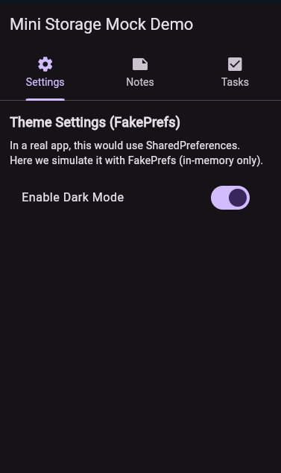
Lab 9 Overview (Offline-First Mini App)
Objectives: Build an Offline-First Multi-Storage App
You will:
Use SharedPreferences to save app theme (Dark/Light mode)
Save & load notes using a local JSON file
CRUD tasks using SQLite (or FakeSQLite)
Handle UI refresh after local storage updates
Understand how three storage layers can work together
Note:
This lab combines concepts from all Demos 9.1 → 9.3.
Notes:
Code demo 9.4 - Mini Integrated
import 'package:flutter/material.dart';
void main() {
runApp(const MiniStorageMockApp());
}
/// Root app: 3 tabs + fake theme persistence
class MiniStorageMockApp extends StatefulWidget {
const MiniStorageMockApp({super.key});
@override
State<MiniStorageMockApp> createState() => _MiniStorageMockAppState();
}
class _MiniStorageMockAppState extends State<MiniStorageMockApp> {
bool _isDark = false;
bool _prefsLoaded = false;
@override
void initState() {
super.initState();
_loadTheme();
}
// Fake "SharedPreferences" (in-memory only)
Future<void> _loadTheme() async {
final prefs = await FakePrefs.getInstance();
setState(() {
_isDark = prefs.getBool('isDarkMode') ?? false;
_prefsLoaded = true;
});
}
Future<void> _toggleTheme(bool value) async {
final prefs = await FakePrefs.getInstance();
await prefs.setBool('isDarkMode', value);
setState(() {
_isDark = value;
});
}
@override
Widget build(BuildContext context) {
if (!_prefsLoaded) {
return MaterialApp(
debugShowCheckedModeBanner: false,
theme: ThemeData.dark(),
home: const Scaffold(
body: Center(child: CircularProgressIndicator()),
),
);
}
final lightTheme = ThemeData(
colorScheme: ColorScheme.fromSeed(
seedColor: Colors.blue,
brightness: Brightness.light,
),
useMaterial3: true,
);
final darkTheme = ThemeData(
colorScheme: ColorScheme.fromSeed(
seedColor: Colors.deepPurple,
brightness: Brightness.dark,
),
useMaterial3: true,
);
return MaterialApp(
title: 'Mini Storage Mock Demo',
debugShowCheckedModeBanner: false,
themeMode: _isDark ? ThemeMode.dark : ThemeMode.light,
theme: lightTheme,
darkTheme: darkTheme,
home: DefaultTabController(
length: 3,
child: Scaffold(
appBar: AppBar(
title: const Text('Mini Storage Mock Demo'),
bottom: const TabBar(
tabs: [
Tab(icon: Icon(Icons.settings), text: 'Settings'),
Tab(icon: Icon(Icons.note), text: 'Notes'),
Tab(icon: Icon(Icons.check_box), text: 'Tasks'),
],
),
),
body: TabBarView(
children: [
SettingsTab(
isDark: _isDark,
onThemeChanged: _toggleTheme,
),
const NotesTab(),
const TasksTab(),
],
),
),
),
);
}
}
//
// ──────────────────────────────────────────────
// Fake SharedPreferences (Part: Theme Mode)
// ──────────────────────────────────────────────
//
class FakePrefs {
FakePrefs._internal();
static final FakePrefs _instance = FakePrefs._internal();
final Map<String, Object?> _store = {};
static Future<FakePrefs> getInstance() async {
// simulate async init
await Future.delayed(const Duration(milliseconds: 150));
return _instance;
}
bool? getBool(String key) {
final v = _store[key];
return v is bool ? v : null;
}
Future<void> setBool(String key, bool value) async {
await Future.delayed(const Duration(milliseconds: 80));
_store[key] = value;
}
}
//
// ──────────────────────────────────────────────
// TAB 1: Settings (FakePrefs for theme)
// ──────────────────────────────────────────────
//
class SettingsTab extends StatelessWidget {
final bool isDark;
final ValueChanged<bool> onThemeChanged;
const SettingsTab({
super.key,
required this.isDark,
required this.onThemeChanged,
});
@override
Widget build(BuildContext context) {
return ListView(
padding: const EdgeInsets.all(16),
children: [
const Text(
'Theme Settings (FakePrefs)',
style: TextStyle(fontSize: 18, fontWeight: FontWeight.bold),
),
const SizedBox(height: 8),
const Text(
'In a real app, this would use SharedPreferences.\n'
'Here we simulate it with FakePrefs (in-memory only).',
),
const SizedBox(height: 16),
SwitchListTile(
title: const Text('Enable Dark Mode'),
value: isDark,
onChanged: onThemeChanged,
),
],
);
}
}
//
// ──────────────────────────────────────────────
// Fake JSON Store (Part: Local JSON file)
// ──────────────────────────────────────────────
//
class FakeJsonNotesStore {
FakeJsonNotesStore._internal();
static final FakeJsonNotesStore instance = FakeJsonNotesStore._internal();
final List<String> _notes = [];
Future<List<String>> loadNotes() async {
await Future.delayed(const Duration(milliseconds: 120));
// return a copy to avoid direct mutation
return List<String>.from(_notes);
}
Future<void> addNote(String note) async {
await Future.delayed(const Duration(milliseconds: 80));
_notes.add(note);
}
Future<void> deleteNoteAt(int index) async {
await Future.delayed(const Duration(milliseconds: 80));
if (index >= 0 && index < _notes.length) {
_notes.removeAt(index);
}
}
}
//
// ──────────────────────────────────────────────
// TAB 2: Notes (Fake JSON file)
// ──────────────────────────────────────────────
//
class NotesTab extends StatefulWidget {
const NotesTab({super.key});
@override
State<NotesTab> createState() => _NotesTabState();
}
class _NotesTabState extends State<NotesTab> {
bool _loading = true;
List<String> _notes = [];
final _store = FakeJsonNotesStore.instance;
@override
void initState() {
super.initState();
_loadNotes();
}
Future<void> _loadNotes() async {
setState(() => _loading = true);
_notes = await _store.loadNotes();
setState(() => _loading = false);
}
Future<void> _addNote() async {
final controller = TextEditingController();
final result = await showDialog<String>(
context: context,
builder: (context) {
return AlertDialog(
title: const Text('New Note'),
content: TextField(
controller: controller,
autofocus: true,
decoration: const InputDecoration(
hintText: 'Type a simple note...',
),
maxLines: 3,
),
actions: [
TextButton(
onPressed: () => Navigator.pop(context),
child: const Text('Cancel'),
),
ElevatedButton(
onPressed: () {
final text = controller.text.trim();
if (text.isNotEmpty) {
Navigator.pop(context, text);
}
},
child: const Text('Save'),
),
],
);
},
);
if (result != null) {
await _store.addNote(result);
await _loadNotes();
}
}
Future<void> _deleteNoteAt(int index) async {
await _store.deleteNoteAt(index);
await _loadNotes();
}
@override
Widget build(BuildContext context) {
if (_loading) {
return const Center(child: CircularProgressIndicator());
}
return Column(
children: [
Padding(
padding: const EdgeInsets.all(16),
child: Row(
children: [
const Expanded(
child: Text(
'Notes (Fake JSON Store)',
style: TextStyle(fontSize: 18, fontWeight: FontWeight.bold),
),
),
ElevatedButton.icon(
onPressed: _addNote,
icon: const Icon(Icons.add),
label: const Text('Add'),
),
],
),
),
Expanded(
child: _notes.isEmpty
? const Center(child: Text('No notes yet. Tap "Add" to create.'))
: ListView.builder(
itemCount: _notes.length,
itemBuilder: (context, index) {
final note = _notes[index];
return Dismissible(
key: ValueKey('$note-$index'),
direction: DismissDirection.endToStart,
background: Container(
color: Colors.red,
alignment: Alignment.centerRight,
padding: const EdgeInsets.symmetric(horizontal: 16),
child: const Icon(Icons.delete, color: Colors.white),
),
onDismissed: (_) => _deleteNoteAt(index),
child: ListTile(
title: Text(note),
),
);
},
),
),
],
);
}
}
//
// ──────────────────────────────────────────────
// Fake "SQLite" for Tasks (like FakeDatabase)
// ──────────────────────────────────────────────
//
class FakeTaskDb {
FakeTaskDb._internal();
static final FakeTaskDb instance = FakeTaskDb._internal();
final List<Map<String, dynamic>> _rows = [];
int _autoId = 0;
Future<List<Map<String, dynamic>>> queryAll() async {
await Future.delayed(const Duration(milliseconds: 100));
return List<Map<String, dynamic>>.from(_rows.reversed);
}
Future<int> insert(String title) async {
await Future.delayed(const Duration(milliseconds: 80));
final row = {
'id': ++_autoId,
'title': title,
'isDone': 0,
};
_rows.add(row);
return row['id'] as int;
}
Future<void> update(int id, bool isDone) async {
await Future.delayed(const Duration(milliseconds: 80));
final index = _rows.indexWhere((r) => r['id'] == id);
if (index != -1) {
_rows[index]['isDone'] = isDone ? 1 : 0;
}
}
Future<void> delete(int id) async {
await Future.delayed(const Duration(milliseconds: 80));
_rows.removeWhere((r) => r['id'] == id);
}
}
class Task {
final int id;
final String title;
final bool isDone;
Task({
required this.id,
required this.title,
required this.isDone,
});
factory Task.fromMap(Map<String, dynamic> map) {
return Task(
id: map['id'] as int,
title: map['title'] as String,
isDone: (map['isDone'] as int) == 1,
);
}
}
//
// ──────────────────────────────────────────────
// TAB 3: Tasks (Fake SQLite)
// ──────────────────────────────────────────────
//
class TasksTab extends StatefulWidget {
const TasksTab({super.key});
@override
State<TasksTab> createState() => _TasksTabState();
}
class _TasksTabState extends State<TasksTab> {
final _db = FakeTaskDb.instance;
bool _loading = true;
List<Task> _tasks = [];
@override
void initState() {
super.initState();
_loadTasks();
}
Future<void> _loadTasks() async {
setState(() => _loading = true);
final rows = await _db.queryAll();
_tasks = rows.map((e) => Task.fromMap(e)).toList();
setState(() => _loading = false);
}
Future<void> _addTask() async {
final controller = TextEditingController();
final result = await showDialog<String>(
context: context,
builder: (context) {
return AlertDialog(
title: const Text('New Task'),
content: TextField(
controller: controller,
autofocus: true,
decoration: const InputDecoration(hintText: 'Enter task...'),
),
actions: [
TextButton(
onPressed: () => Navigator.pop(context),
child: const Text('Cancel'),
),
ElevatedButton(
onPressed: () {
final text = controller.text.trim();
if (text.isNotEmpty) {
Navigator.pop(context, text);
}
},
child: const Text('Add'),
),
],
);
},
);
if (result != null) {
await _db.insert(result);
await _loadTasks();
}
}
Future<void> _toggleTask(Task task) async {
await _db.update(task.id, !task.isDone);
await _loadTasks();
}
Future<void> _deleteTask(Task task) async {
await _db.delete(task.id);
await _loadTasks();
}
@override
Widget build(BuildContext context) {
if (_loading) {
return const Center(child: CircularProgressIndicator());
}
return Column(
children: [
Padding(
padding: const EdgeInsets.all(16),
child: Row(
children: [
const Expanded(
child: Text(
'Tasks (Fake SQLite)',
style: TextStyle(fontSize: 18, fontWeight: FontWeight.bold),
),
),
ElevatedButton.icon(
onPressed: _addTask,
icon: const Icon(Icons.add),
label: const Text('Add'),
),
],
),
),
Expanded(
child: _tasks.isEmpty
? const Center(child: Text('No tasks yet. Tap "Add" to create.'))
: ListView.builder(
itemCount: _tasks.length,
itemBuilder: (context, index) {
final task = _tasks[index];
return Dismissible(
key: ValueKey(task.id),
direction: DismissDirection.endToStart,
background: Container(
color: Colors.red,
alignment: Alignment.centerRight,
padding: const EdgeInsets.symmetric(horizontal: 16),
child: const Icon(Icons.delete, color: Colors.white),
),
onDismissed: (_) => _deleteTask(task),
child: CheckboxListTile(
value: task.isDone,
title: Text(
task.title,
style: task.isDone
? const TextStyle(
decoration: TextDecoration.lineThrough,
color: Colors.grey,
)
: null,
),
onChanged: (_) => _toggleTask(task),
),
);
},
),
),
],
);
}
}

Slide 23
Summary
You learned the three main local-storage methods in Flutter:
SharedPreferences, Local JSON files, and SQLite/SQFlite.
SharedPreferences: best for small key-value data (theme, flags), fast and simple.
JSON files: good for document-style data (notes, cache), flexible and easy to import/export.
SQLite/SQFlite: ideal for large, structured data with full CRUD and query support.
Demos 9.1 → 9.3 built an Offline-First mini app: save theme → save notes → manage todos with SQLite.

Slide 24
References
Mastering Flutter 2025, Chapters 9, 11
docs.flutter.dev
https://dartpad.dev
path_provider Flutter plugin
SharedPreferences Flutter plugin

